Slide 1
Chapter 2:
Introduction to Ethics

Slide 2
Chapter Overview
Introduction
Review of nine ethical theories
Comparing workable ethical theories
Morality of breaking the law
1-<number>

Slide 3
2.1 Introduction
1-<number>

Slide 4

We Live in Communities
(London, England at night from space)
Courtesy of NASA
1-<number>

Slide 5
The Ethical Point of View
Most everyone shares “core values”, desiring:
  Life
  Happiness
  Ability to accomplish goals
Two ways to view world
  Selfish point of view: consider only your own self and your core values
  Ethical point of view: respect other people and their core values
1-<number>

Slide 6
Defining Terms
Society
  Association of people organized under a system of rules
  Rules: advance the good of members over time
Morality
  A society’s rules of conduct
  What people ought / ought not to do in various situations
Ethics
  Rational examination of morality
  Evaluation of people’s behavior
1-<number>

Slide 7
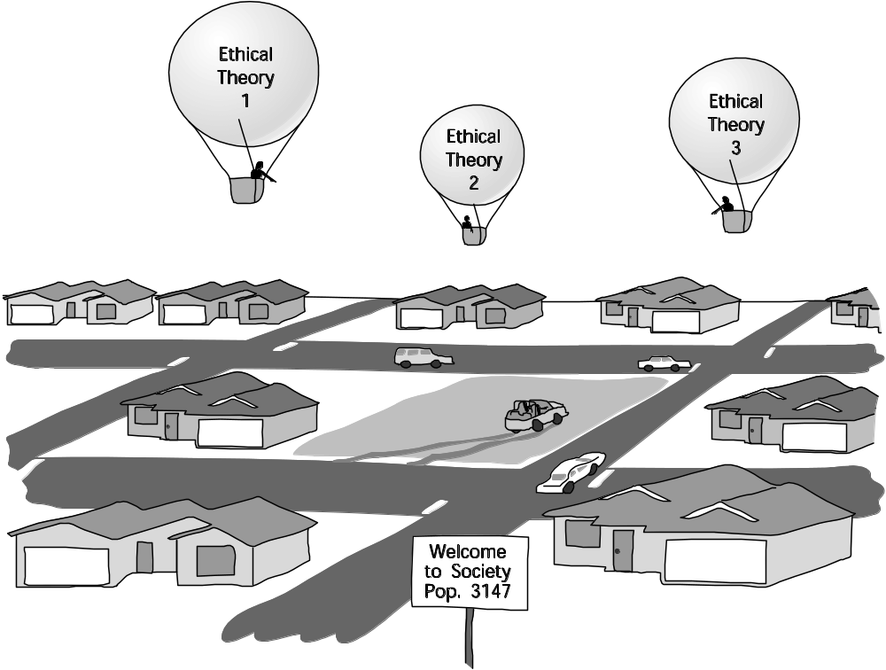
Analogy for Difference between Morality and Ethics
1-<number>

Slide 8
Why Study Ethics?
Ethics: a way to decide the best thing to do
New problems accompany new technologies
“Common wisdom” may not exist for novel situations brought about by new technologies
1-<number>

Slide 9
Scenario 1
Alexis, a gifted high school student, wants to become a doctor. Because she comes from a poor family, she will need a scholarship in order to attend college. Some of her classes require students to do extra research projects in order to get an A. Her high school has a few older PCs, but there are always long lines of students waiting to use them during the school day. After school, she usually works at a part-time job to help support her family. One evening Alexis visits the library of a private college a few miles from her family’s apartment, and she finds plenty of unused PCs connected to the Internet. She surreptitiously looks over the shoulder of another student to learn a valid login/password combination. Alexis returns to the library several times a week, and by using its PCs and printers she efficiently completes the extra research projects, graduates from high school with straight A’s, and gets a full ride scholarship to attend a prestigious university.
1-<number>

Slide 10
Scenario 1
Did Alexis do anything wrong?
Who benefited from Alexis’s course of action?
Who was hurt by Alexis’s course of action?
Did Alexis have an unfair advantage over her high school classmates?
Would any of your answers change if it turns out Alexis did not win a college scholarship after all?
Are there better ways Alexis could have achieved her objective?
What additional information, if any, would help you answer the previous questions?
1-<number>

Slide 11
Scenario 2
An organization dedicated to reducing spam tries to get Internet service providers (ISPs) in an East Asian country to stop the spammers by protecting their mail servers. When this effort is unsuccessful, the antispam organization puts the addresses of these ISPs on its blacklist. Many ISPs in the United States consult the blacklist and refuse to accept email from the blacklisted ISPs. This action has two results. First, the amount of spam received by the typical email user in the United States drops by 25 percent. Second, tens of thousands of innocent computer users in the East Asian country are unable to send email to friends and business associates in the United States.
1-<number>

Slide 12
Scenario 2
Did the antispam organization do anything wrong?
Did the ISPs that refused to accept email from the blacklisted ISPs do anything wrong?
Who benefited from the organization’s action?
Who was hurt by the organization’s action?
Could the organization have achieved its goals through a better course of action?
What additional information, if any, would help you answer the previous questions?
1-<number>

Slide 13
Scenario 3
In an attempt to deter speeders, the East Dakota State Police (EDSP) installs video cameras on all of its freeway overpasses. The cameras are connected to computers that can reliably detect cars traveling more than five miles per hour above the speed limit. These computers have sophisticated image recognition software that enables them to read license plate numbers and capture high resolution pictures of vehicle drivers. If the picture of the driver matches the driver’s license photo of one of the registered owners of the car, the system issues a speeding ticket to the driver, complete with photo evidence. Six months after the system is put into operation, the number of people speeding on East Dakota freeways is reduced by 90 percent. The FBI asks the EDSP for real-time access to the information collected by the video cameras. The EDSP complies with this request. Three months later, the FBI uses this information to arrest five members of a terrorist organization.
1-<number>

Slide 14
Scenario 3
Did the East Dakota State Police do anything wrong?
Who benefited from the actions of the EDSP?
Who was harmed by the actions of the EDSP?
What other courses of action could the EDSP have taken to achieve its objectives?
What additional information, if any, would help you answer the previous questions?
1-<number>

Slide 15
Scenario 4
You are the senior software engineer at a start-up company developing an exciting new product that will allow salespeople to generate and email sales quotes and customer invoices from their smartphones. Your company’s sales force has led a major corporation to believe your product will be available next week. Unfortunately, at this point the software still contains quite a few bugs. The leader of the testing group has reported that all of the known bugs appear to be minor, but it will take another month of testing for his team to be confident the product contains no catastrophic errors. Because of the fierce competition in the smartphone software industry, it is critical that your company be “first to market.” To the best of your knowledge, a well-established company will release a similar product in a few weeks. If its product appears first, your start-up company will probably go out of business.
1-<number>

Slide 16
Scenario 4
Should you recommend release of the product next week?
Who will benefit if the company follows your recommendation?
Who will be harmed if the company follows your recommendation?
Do you have an obligation to any group of people that may be affected by your decision?
What additional information, if any, would help you answer the previous questions?
1-<number>

Slide 17
More on Ethics
Ethics: rational, systematic analysis
  “Doing ethics” means explaining conclusions
  Best explanations based on facts, shared values, logic
Ethics focuses on people’s voluntary, moral choices
Workable ethical theory: produces explanations that might be persuasive to a skeptical, yet open-minded audience
1-<number>

Slide 18
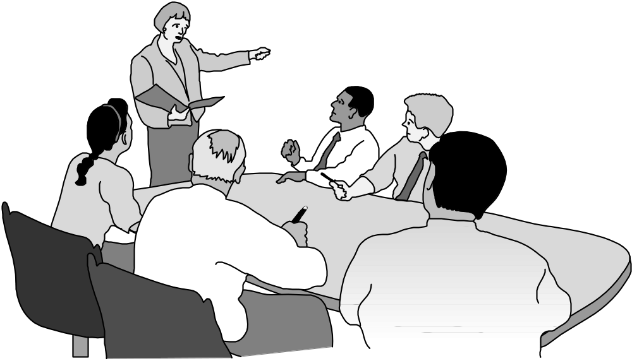
A Good Ethical Theory Supports Persuasive, Logical Arguments
1-<number>

Slide 19
2.2 Subjective Relativism
1-<number>

Slide 20
What Is Relativism?
Relativism
  No universal norms of right and wrong
  One person can say “X is right,” another can say “X is wrong,” and both can be right
Subjective relativism
  Each person decides right and wrong for himself or herself
  “What’s right for you may not be right for me”
1-<number>

Slide 21
Case for Subjective Relativism
Well-meaning and intelligent people disagree on moral issues
Ethical debates are disagreeable and pointless
1-<number>

Slide 22
Case Against Subjective Relativism
Blurs line between doing what you think is right and doing what you want to do
Makes no moral distinction between the actions of different people
SR and tolerance are two different things
Decisions may not be based on reason
Not a workable ethical theory
1-<number>

Slide 23
2.3 Cultural Relativism
1-<number>

Slide 24
Cultural Relativism in a Nutshell
What is “right” and “wrong” depends upon a society’s actual moral guidelines
These guidelines vary from place to place and from time to time
A particular action may be right in one society at one time and wrong in other society or at another time
1-<number>

Slide 25
Case for Cultural Relativism
Different social contexts demand different moral guidelines
It is arrogant for one society to judge another
1-<number>

Slide 26
Case Against Cultural Relativism
Because two societies do have different moral views doesn’t mean they ought to have different views
It doesn’t explain how moral guidelines are determined
What if there are no cultural norms?
It doesn’t account for evolution of moral guidelines.
It provides no way out for cultures in conflict
Existence of many acceptable practices does not imply all practices are acceptable (many/any fallacy)
Societies do, in fact, share certain core values
Only indirectly based on reason
Not a workable ethical theory
1-<number>

Slide 27
2.4 Divine Command Theory
1-<number>

Slide 28
Overview of Divine Command Theory
Good actions: those aligned with God’s will
Bad actions: those contrary to God’s will
Holy books reveal God’s will
We should use holy books as moral decision-making guides
1-<number>

Slide 29
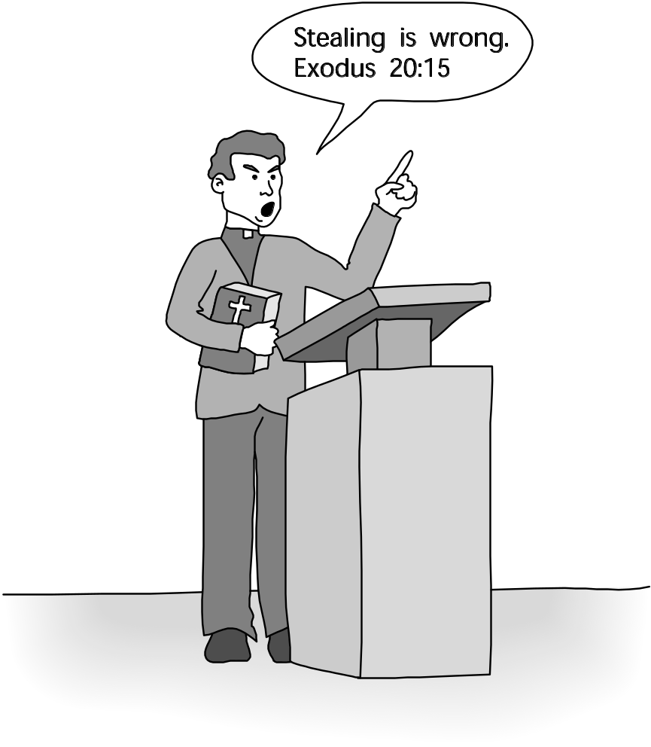
Divine Command Theory in Action
1-<number>

Slide 30
Case for Divine Command Theory
We owe obedience to our Creator
God is all-good and all-knowing
God is the ultimate authority
1-<number>

Slide 31
Case Against Divine Command Theory
Different holy books disagree on certain teachings
Society is multicultural, secular
Some modern moral problems not directly addressed in scripture
“The good” ≠ “God” (equivalence fallacy)
Based on obedience, not reason
Not a workable ethical theory for our purposes
1-<number>

